Slide 1




RESEARCH REPRODUCTIBILITY
This presentation is supported by the project "Education 4.0: Living Labs for the Students of the Future (LLSF)", Contract #2021-1-RO01-KA220-HED-000032176, Erasmus+ KA220-HED

Slide 2

BIO
Ciprian Dobre is a university professor at the Faculty of Automation and Computers and coordinator of the MobyLab laboratory of the Polytechnic University of Bucharest. Specialist in distributed systems, he is the author of scientific achievements in the fields of the Internet of Things, data processing, mobile and Cloud computing, mobile and urban intelligent technologies, communication networks, eHealth, modelling and simulation, etc. More details at https://cipsm.hpc.pub.ro/.
CIPRIAN DOBRE

Slide 3

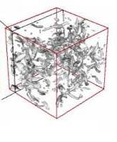

E-SCIENCE AND THE FOURTH PARADIGM
Thousand years ago – Experimental Science
Description of natural phenomena
Last few hundred years – Theoretical Science
Newton’s Laws, Maxwell’s Equations…
Last few decades – Computational Science - Simulation of complex phenomena
Today – Data-Intensive Science
Scientists overwhelmed with data sets
from many different sources
Data captured by instruments
Data generated by simulations
Data generated by sensor networks

Slide 4
1.
DATA SCIENCE AN INTRODUCTION

Slide 5
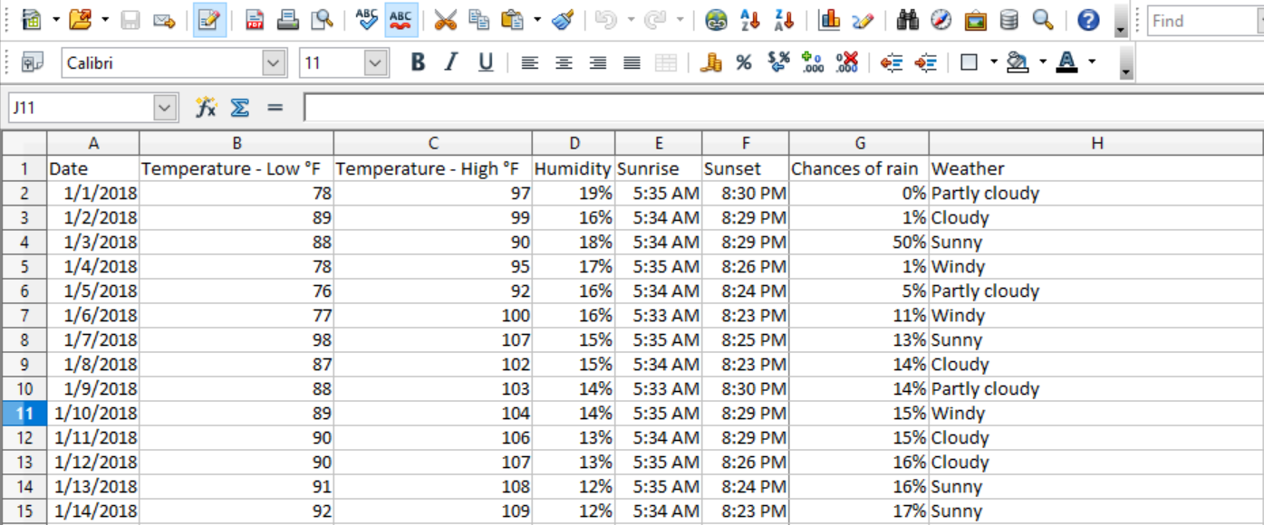

DATA SCIENCE TERMS
A dataset is a table/spreadsheet document with historical information
If you want to understand details about the weather, the dataset will include the historical information about the weather in the past few years. Precipitation, Humidity, Temperature, etc.
Sample snapshot of the dataset

Slide 6
DATA SCIENCE TERMS (cont.)
A variable is like a container that can be assigned a value.
Precipitation, Humidity, temperature etc are variables in the previous example.
Types of variables​:
Independent variables are not influenced by any factors and impact the outcome variable. The outcome variable is ‘chances of rain’. Temperature, Humidity, sunrise, sunset times are independent variables.
Dependent variables are influenced or dependent on the independent variable. For example – the chance of rain depends on the temperature, humidity etc. Depending on the temperature, the chances of rain may increase or decrease.
Any variable with numerical value is considered as continuous. Temperature, humidity, and chances of rain are considered continuous variables.
Any variable with non-numerical value is considered as categorical. Weather is considered a categorical variable.
Descriptive data​: Summarize the data or describe the data in a meaningful way to provide insights about the dataset. Below are some of the key insights that can be provided to describe the data:
Highest and lowest temperature
Did increase in the temperature lower the chances of rain?
Effects of humidity on rain
Weather Vs. chances of rain

Slide 7

DATA SCIENCE PROJECT
1. Importing the Dataset​
We will learn how to import the data set and load it onto the Jupyter Notebook
2. Reviewing the Dataset​
We can review the dataset by looking at the first few rows of data. You can do that by using the head function in python. It helps provide an idea about the data structure.

Slide 8
2.
JUPYTER NOTEBOOKS

Slide 9
JUPYTER NOTEBOOK
A notebook integrates code and its output into a single document that combines visualizations, narrative text, mathematical equations, and other rich media
It is a single document where you can run code, display the output, and also add explanations, formulas, charts, and make your work more transparent, understandable, repeatable, and shareable.
Using Notebooks is now a major part of the data science workflow at companies across the globe
A Notebook will speed up your workflow and make it easier to communicate and share your results.
Jupyter Notebook is an incredibly powerful tool for interactively developing and presenting data science projects
As part of the open source Project Jupyter, Jupyter Notebooks are completely free.
You can download the software on its own, or as part of the Anaconda data science toolkit.

Slide 10
INSTALING JUPYTER NOTEBOOK
The easiest way for a beginner to get started with Jupyter Notebooks is by installing Anaconda.
Anaconda is the most widely used Python distribution for data science and comes pre-loaded with all the most popular libraries and tools.
Some of the biggest Python libraries included in Anaconda include NumPy, pandas, and Matplotlib, though the full 1000+ list is exhaustive.
To get Anaconda, simply:
Download the latest version of Anaconda for Python 3.8.
Install Anaconda by following the instructions on the download page and/or in the executable.
If you are a more advanced user with Python already installed and prefer to manage your packages manually, you can just use pip:
pip3 install jupyter

Slide 11
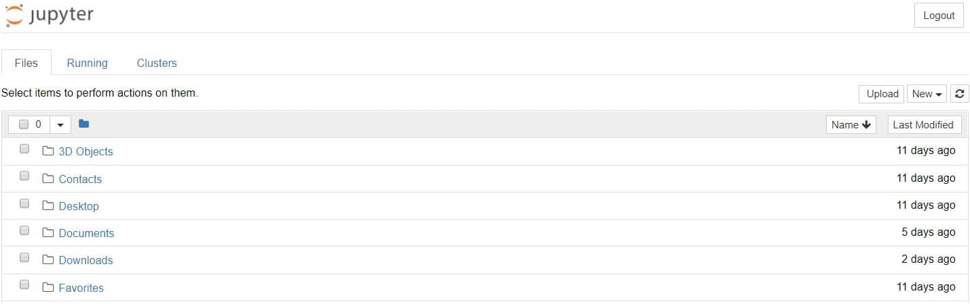
RUNNING JUPYTER NOTEBOOK
One can run Jupyter via the shortcut Anaconda adds to your start menu, or via ‘Jupyter notebook’, which will open a new tab in your default web browser:
This isn’t a notebook just yet, but don’t panic! There’s not much to it. This is the Notebook Dashboard, specifically designed for managing your Jupyter Notebooks. Think of it as the launchpad for exploring, editing and creating your notebooks.

Slide 12
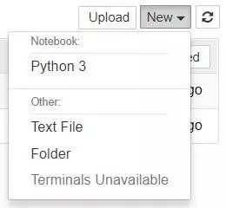
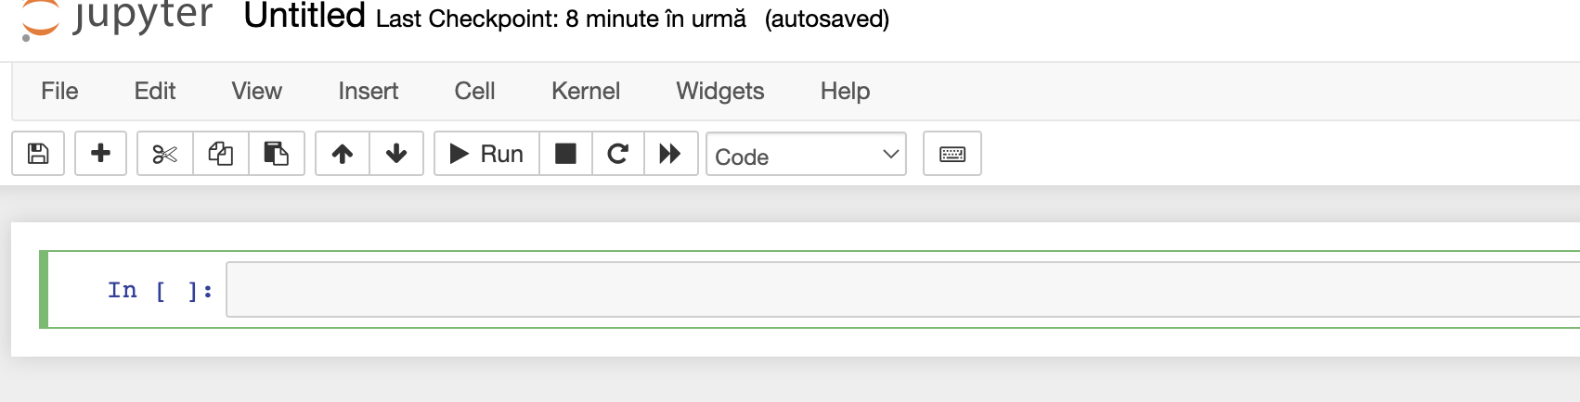
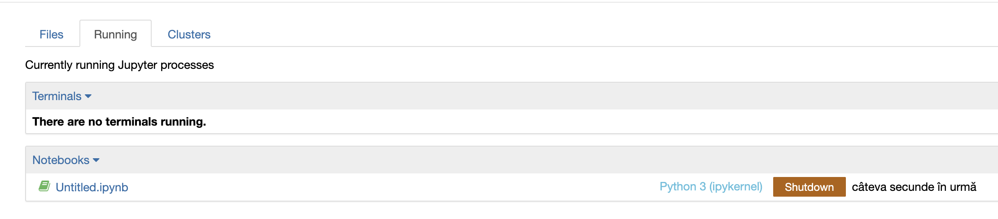
JUPYTER NOTEBOOK
Jupyter’s Notebooks and dashboard are web apps, and Jupyter starts up a local Python server to serve these apps to your web browser, making it essentially platform-independent and opening the door to easier sharing on the web.
Browse to the folder in which you would like to create your first notebook, click the “New” drop-down button in the top-right and select “Python 3”:
Your first Jupyter Notebook will open in new tab — each notebook uses its own tab because you can open multiple notebooks simultaneously.
If you switch back to the dashboard, you will see the new file Untitled.ipynb and you should see some green text that tells you your notebook is running.

Slide 13
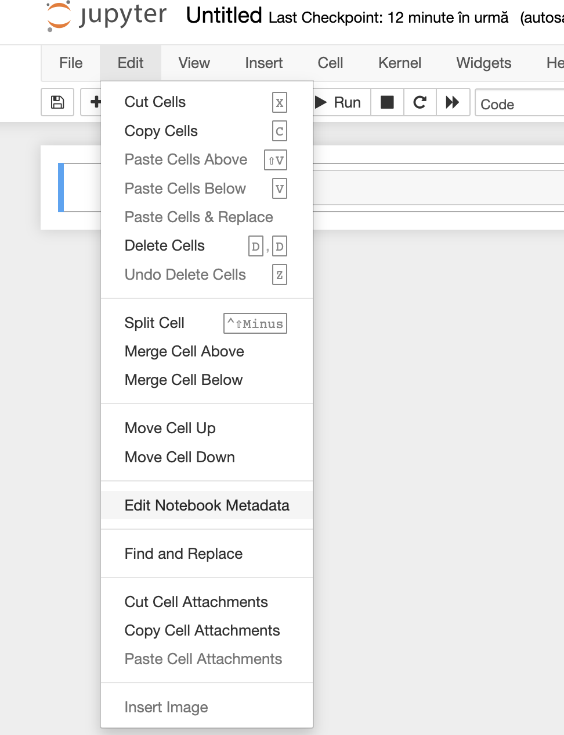
ipynb FILE
Each .ipynb file is one notebook
Each time you create a new notebook, a new .ipynb file will be created.
An .ipynb file is a text file that describes the contents of your notebook in a format called JSON. Each cell and its contents, including image attachments that have been converted into strings of text, is listed therein along with medatadata.
You can edit this yourself — if you know what you are doing! — by selecting “Edit > Edit Notebook Metadata” from the menu bar in the notebook. You can also view the contents of your notebook files by selecting “Edit” from the controls on the dashboard
However, the key word there is can. In most cases, there’s no reason you should ever need to edit your notebook metadata manually.

Slide 14
NOTEBOOK TERMS
There are two Notebook terms that we work with: cells and kernels

Slide 15
NOTEBOOK TERMS
There are two Notebook terms that we work with: cells and kernels
A kernel is a “computational engine” that executes the code contained in a notebook document.

Slide 16
NOTEBOOK TERMS
There are two Notebook terms that we work with: cells and kernels
A kernel is a “computational engine” that executes the code contained in a notebook document.
A cell is a container for text to be displayed in the notebook or code to be executed by the notebook’s kernel

Slide 17
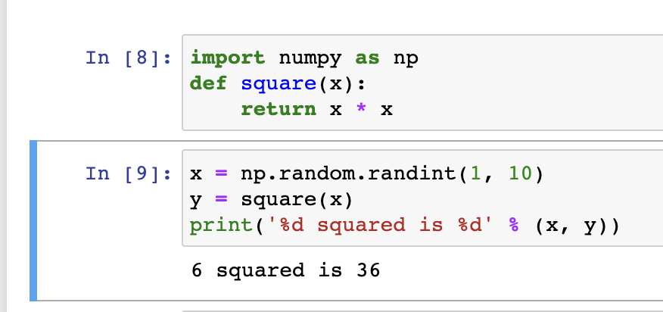
KERNELS
Behind every notebook runs a kernel
When you run a code cell, that code is executed within the kernel.
Any output is returned back to the cell to be displayed.
The kernel’s state persists over time and between cells — it pertains to the document as a whole and not individual cells.
For example, if you import libraries or declare variables in one cell, they will be available in another. Let’s try this out to get a feel for it:

Slide 18
CHOOSING A KERNEL
You may have noticed that Jupyter gives you the option to change kernel, and in fact there are many different options to choose from.
Back when you created a new notebook from the dashboard by selecting a Python version, you were actually choosing which kernel to use.
There kernels for different versions of Python, and also for over 100 languages including Java, C, and even Fortran.
Data scientists may be particularly interested in the kernels for R and Julia, as well as both imatlab and the Calysto MATLAB Kernel for Matlab.
The SoS kernel provides multi-language support within a single notebook.

Slide 19
CELLS
Cells form the body of a notebook.
There are two main cell types :
A code cell contains code to be executed in the kernel.
When the code is run, the notebook displays the output below the code cell that generated it.
The first cell in a new notebook is always a code cell.
A Markdown cell contains text formatted using Markdown and displays its output in-place when the Markdown cell is run.
Let’s test it out with a classic hello world example:
Type print('Hello World!') into the cell and click the run button Notebook Run Button in the toolbar above or press Ctrl (or CMD) + Enter.

Slide 20

CELLS (cont.)
Notice the difference? When we run the cell, its output is displayed below and the label to its left will have changed from In [ ] to In [1]
The “In” part of the label is simply short for “Input,” while the label number indicates when the cell was executed on the kernel — in this case the cell was executed first.
Run the cell again and the label will change to In [2] because now the cell was the second to be run on the kernel.
The output of a code cell also forms part of the document
You can always tell the difference between code and Markdown cells because code cells have that label on the left and Markdown cells do not.

Slide 21
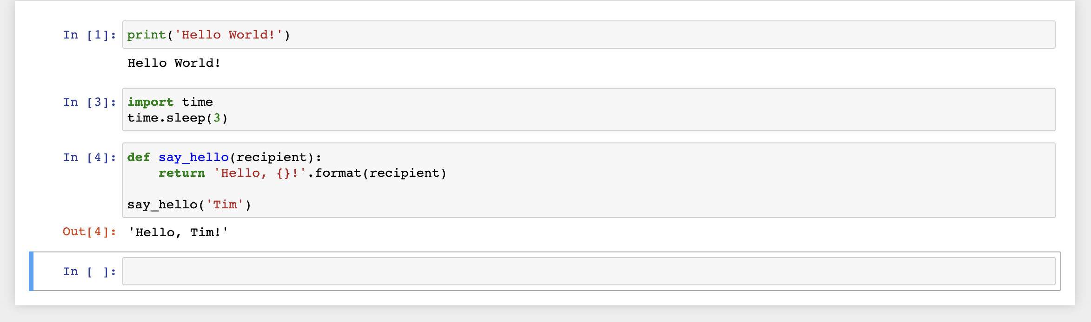
CELLS (cont.)
In general, the output of a cell comes from any text data specifically printed during the cell’s execution, as well as the value of the last line in the cell, be it a lone variable, a function call, or something else.

Slide 22
KEYBOARD SHORTCUTS
One thing you may have observed when running your cells is that their border turns blue, whereas it was green while you were editing.
In a Jupyter Notebook, there is always one “active” cell highlighted with a border whose color denotes its current mode:
Green outline — cell is in “edit mode”
Blue outline — cell is in “command mode”
Keyboard shortcuts are a very popular aspect of the Jupyter environment because they facilitate a speedy cell-based workflow. Many of these are actions you can carry out on the active cell when it’s in command mode.
Scroll up and down your cells with your Up and Down keys.
Press A or B to insert a new cell above or below the active cell.
M will transform the active cell to a Markdown cell.
Y will set the active cell to a code cell.
D + D (D twice) will delete the active cell.
Z will undo cell deletion.
Hold Shift and press Up or Down to select multiple cells at once. With multiple cells selected, Shift + M will merge your selection.
Ctrl + Shift + -, in edit mode, will split the active cell at the cursor.
You can also click and Shift + Click in the margin to the left of your cells to select them.

Slide 23
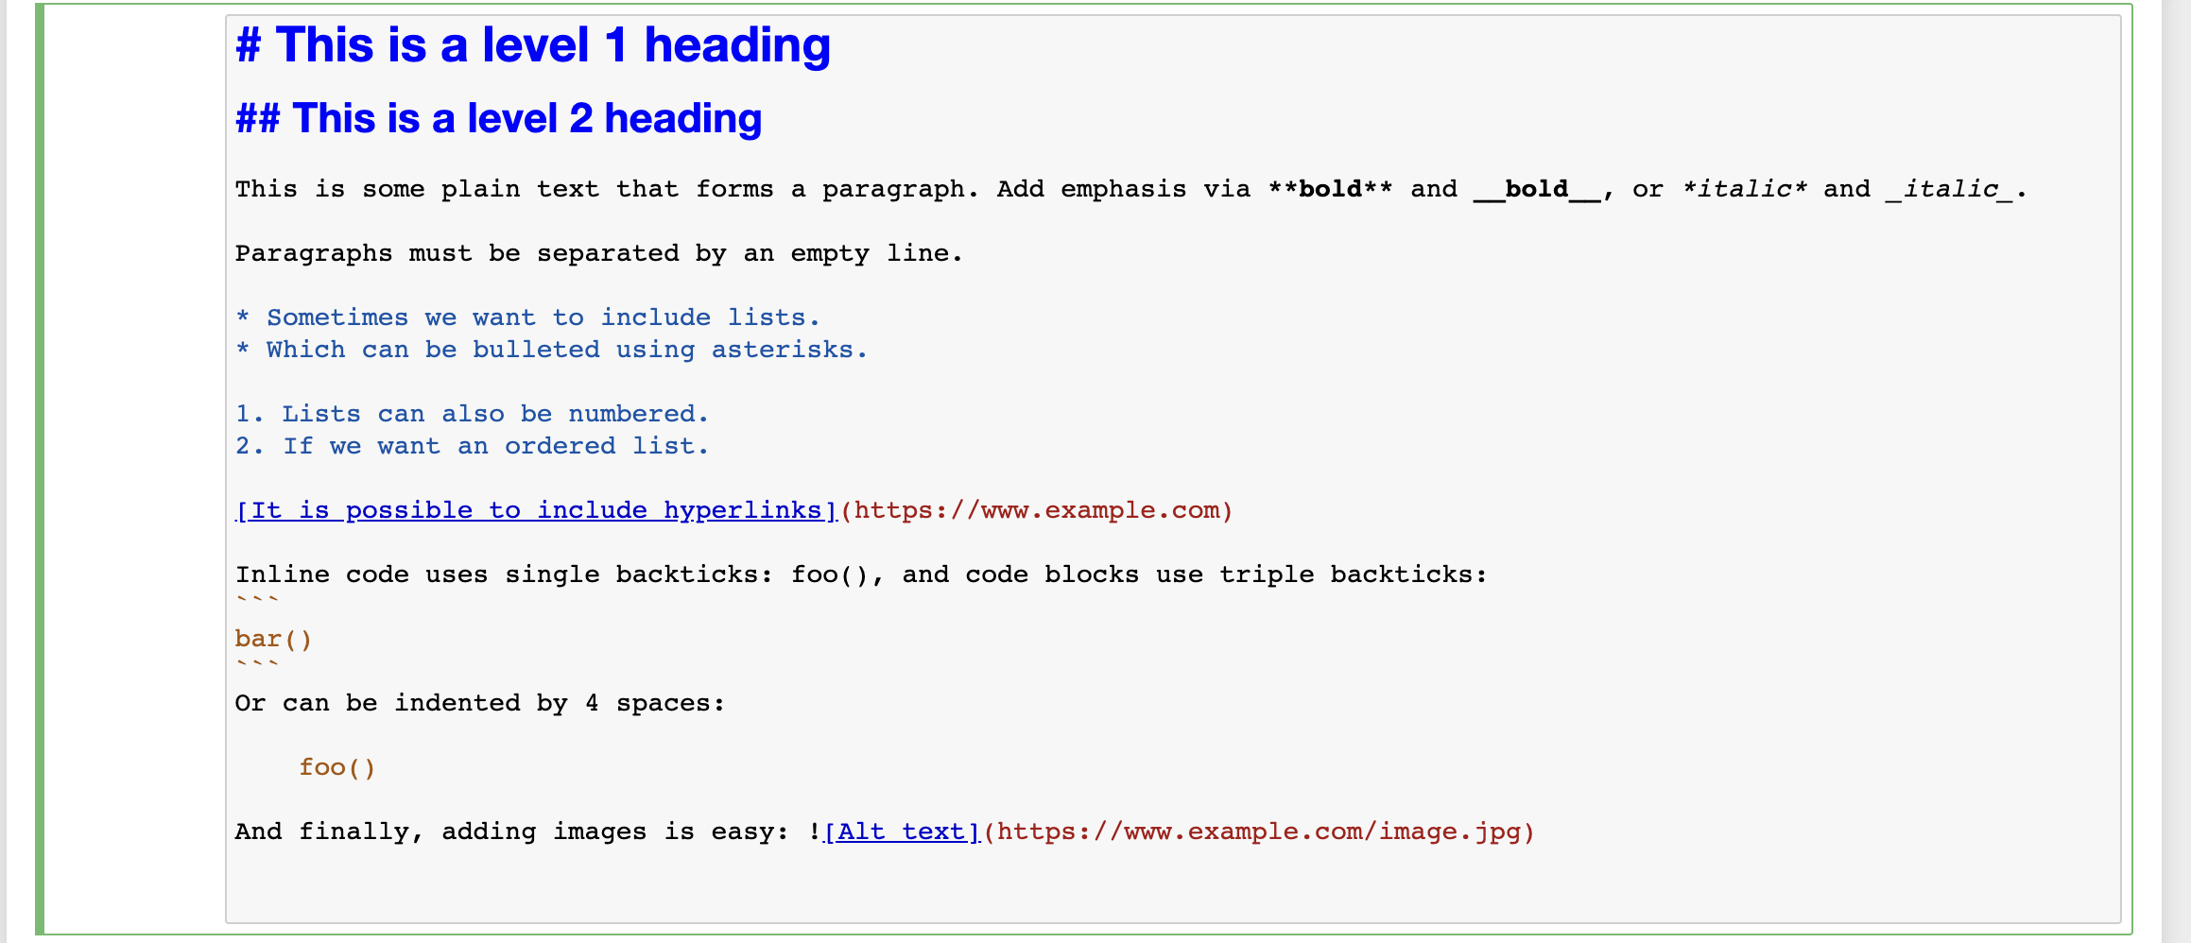
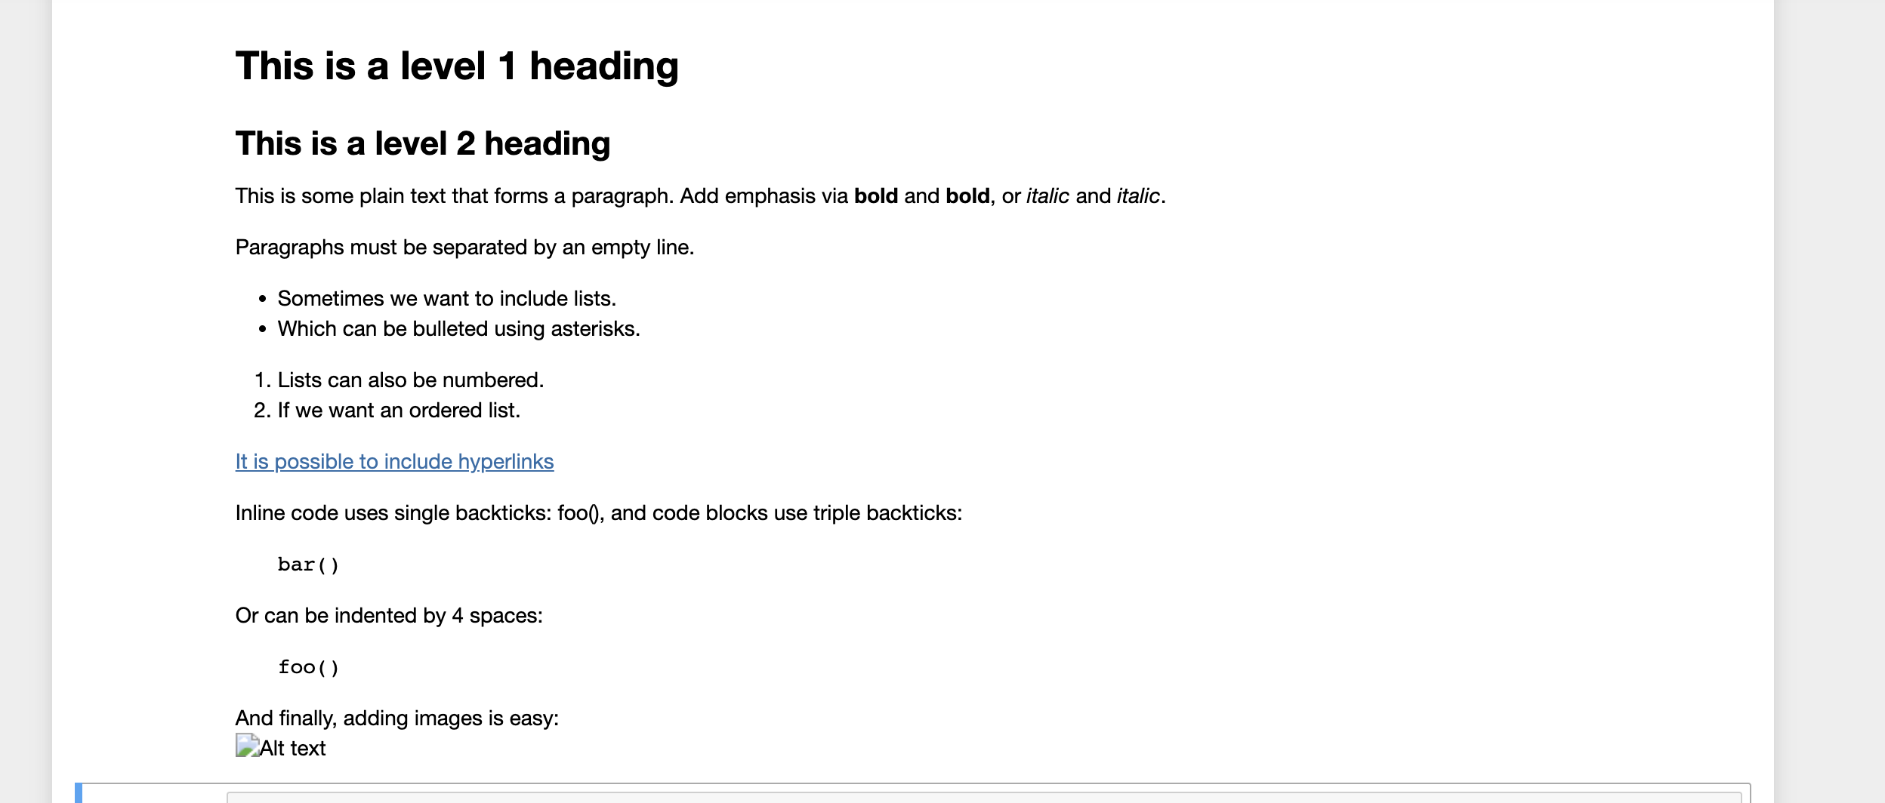
MARKDOWN
Markdown is a lightweight, easy to learn markup language for formatting plain text
Its syntax has a one-to-one correspondence with HTML tags, so some prior knowledge here would be helpful but is definitely not a prerequisite

Slide 24

A LITTLE EXAMPLE …

Slide 25
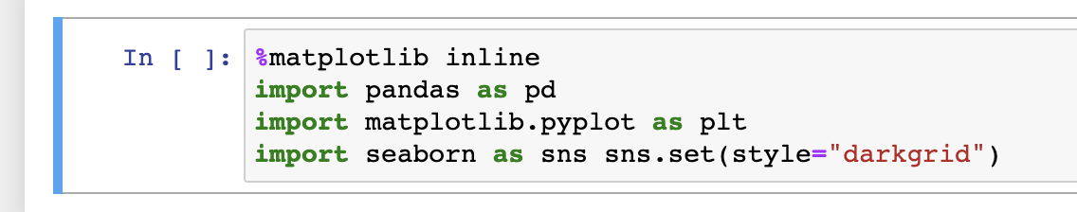
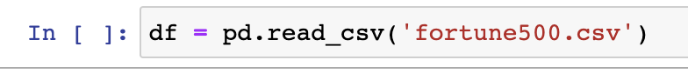
SETUP
It’s common to start off with a code cell specifically for imports and setup, so that if you choose to add or change anything, you can simply edit and re-run the cell without causing any side-effects.
work with data
plot charts
visual charts
read data

Slide 26
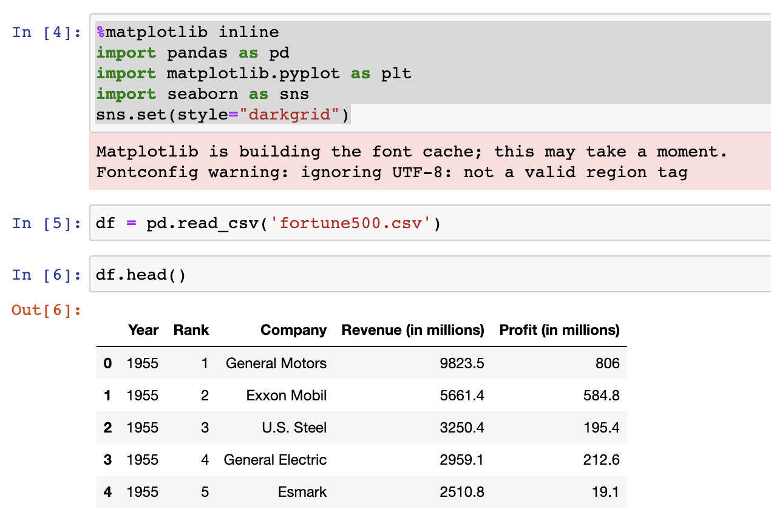
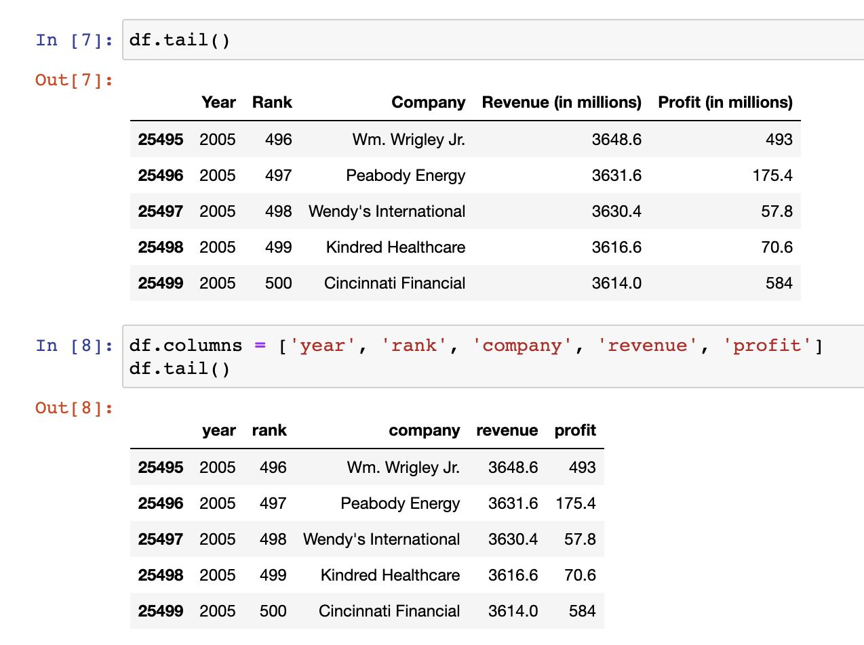
WORK WITH DATA
We’ve loaded our data set df into the most-used pandas data structure, which is called a DataFrame and basically looks like a table:

Slide 27
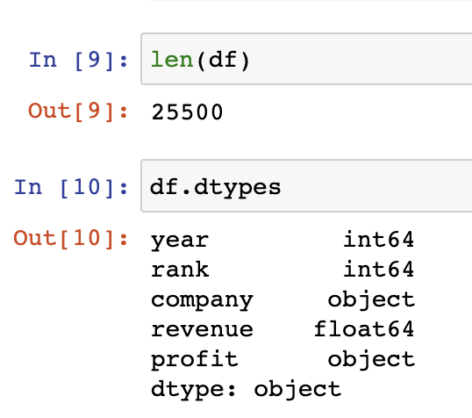
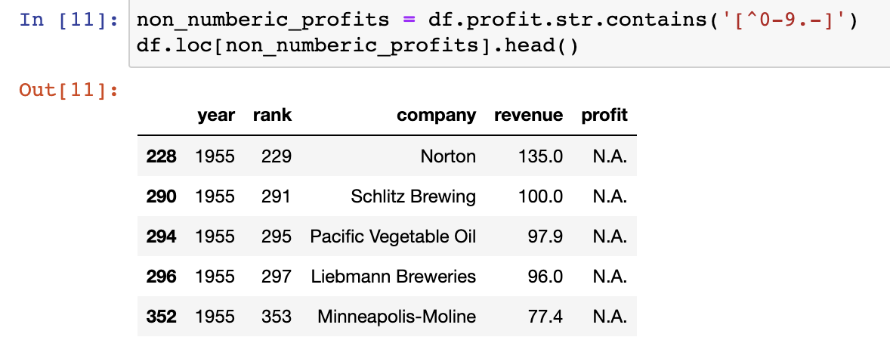
EPLORING THE DATA
Hmm, not float64?
Just as we suspected! Some of the values are strings, which have been used to indicate missing data. Are there any other values that have crept in?

Slide 28
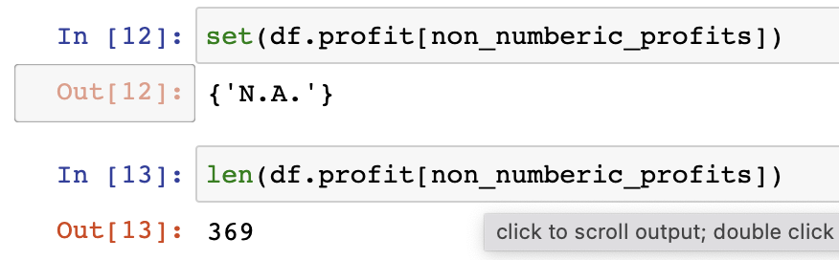
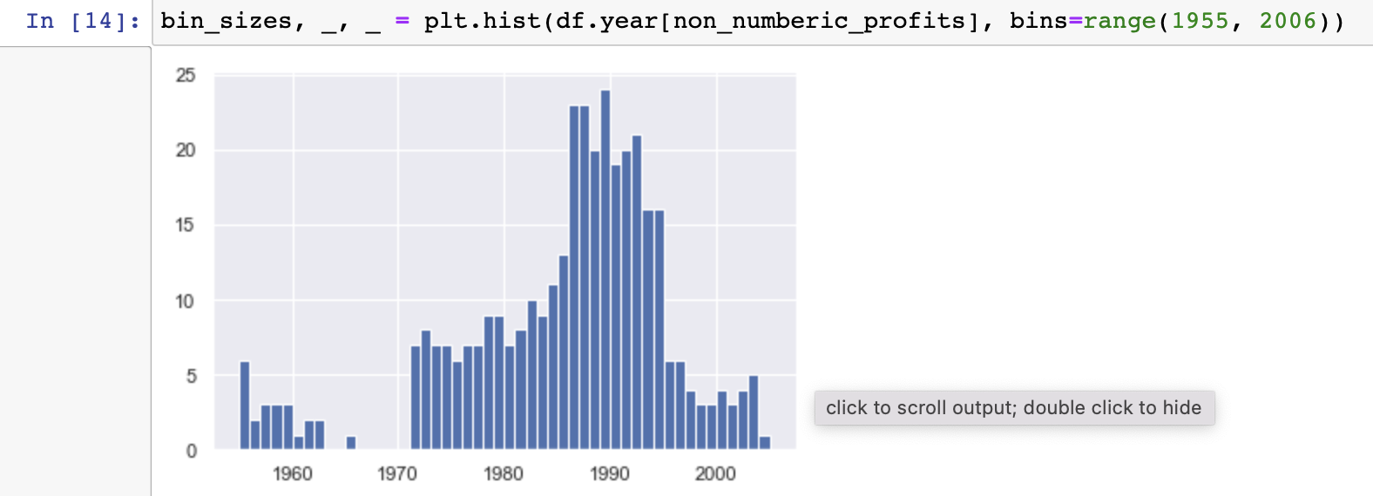
EPLORING THE DATA (cont.)
That makes it easy to interpret, but what should we do?
It’s a small fraction of our data set, though not completely inconsequential as it is still around 1.5%.
If rows containing N.A. are, roughly, uniformly distributed over the years, the easiest solution would just be to remove them. So let’s have a quick look at the distribution.
At a glance, we can see that the most invalid values in a single year is fewer than 25, and as there are 500 data points per year, removing these values would account for less than 4% of the data for the worst years. Indeed, other than a surge around the 90s, most years have fewer than half the missing values of the peak.

Slide 29
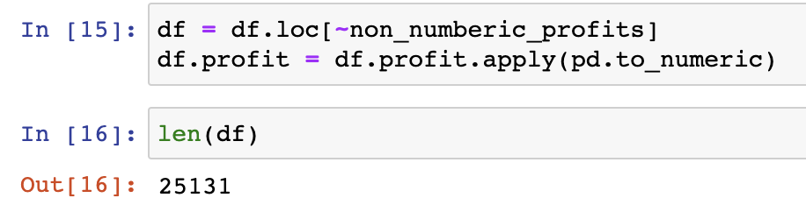
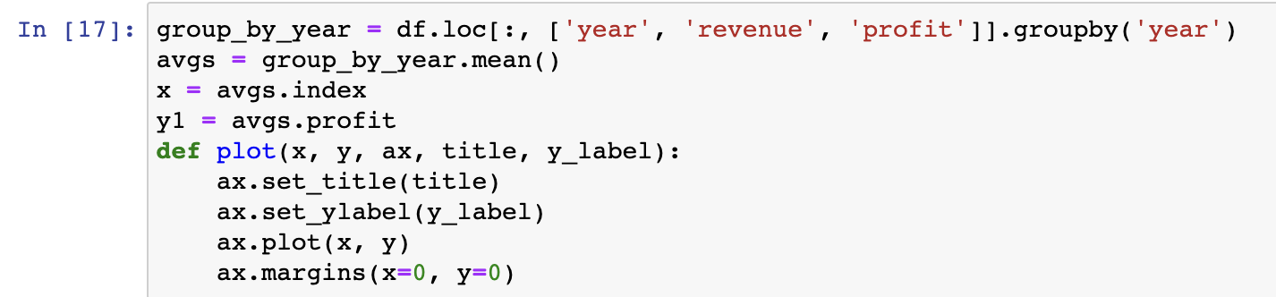
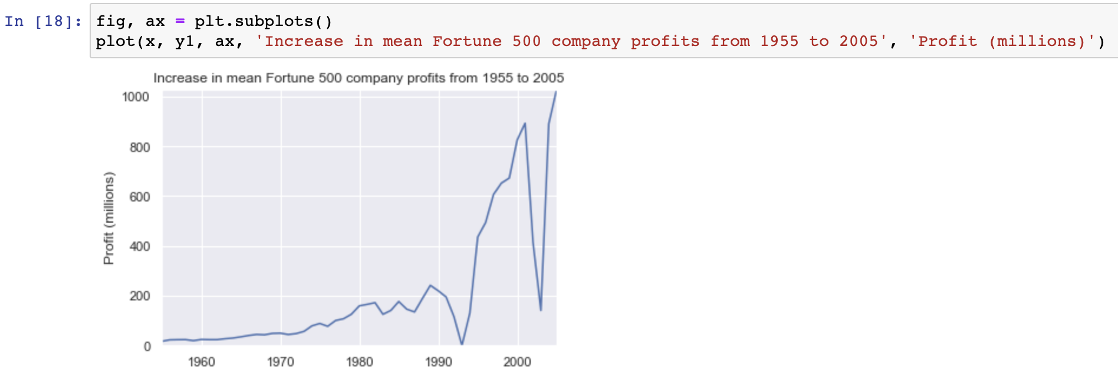
EPLORING THE DATA (cont.)
let’s say this is acceptable and go ahead and remove these rows
Next, we address our goal and plot average profit by year. We might as well plot the revenue as well, so first we can define some variables and a method to reduce our code.
let’s plot!

Slide 30
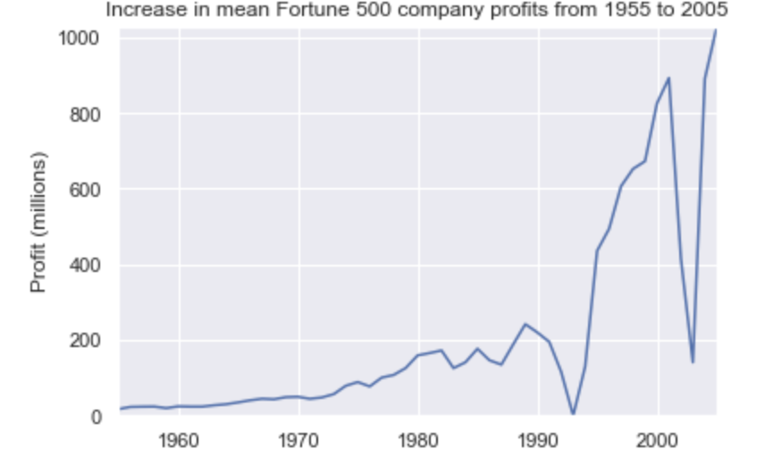
LOOKING AT THE RESULTS
Wow, that looks like an exponential, but it’s got some huge dips. They must correspond to the early 1990s recession and the dot-com bubble. It’s pretty interesting to see that in the data. But how come profits recovered to even higher levels post each recession?
Maybe the revenues can tell us more...

Slide 31
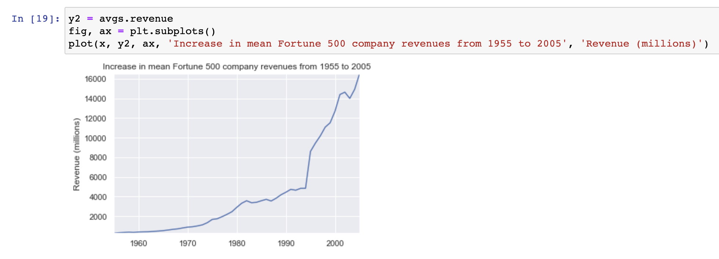
FURTHER ANALYSIS
That adds another side to the story. Revenues were not as badly hit — that’s some great accounting work from the finance departments.

Slide 32
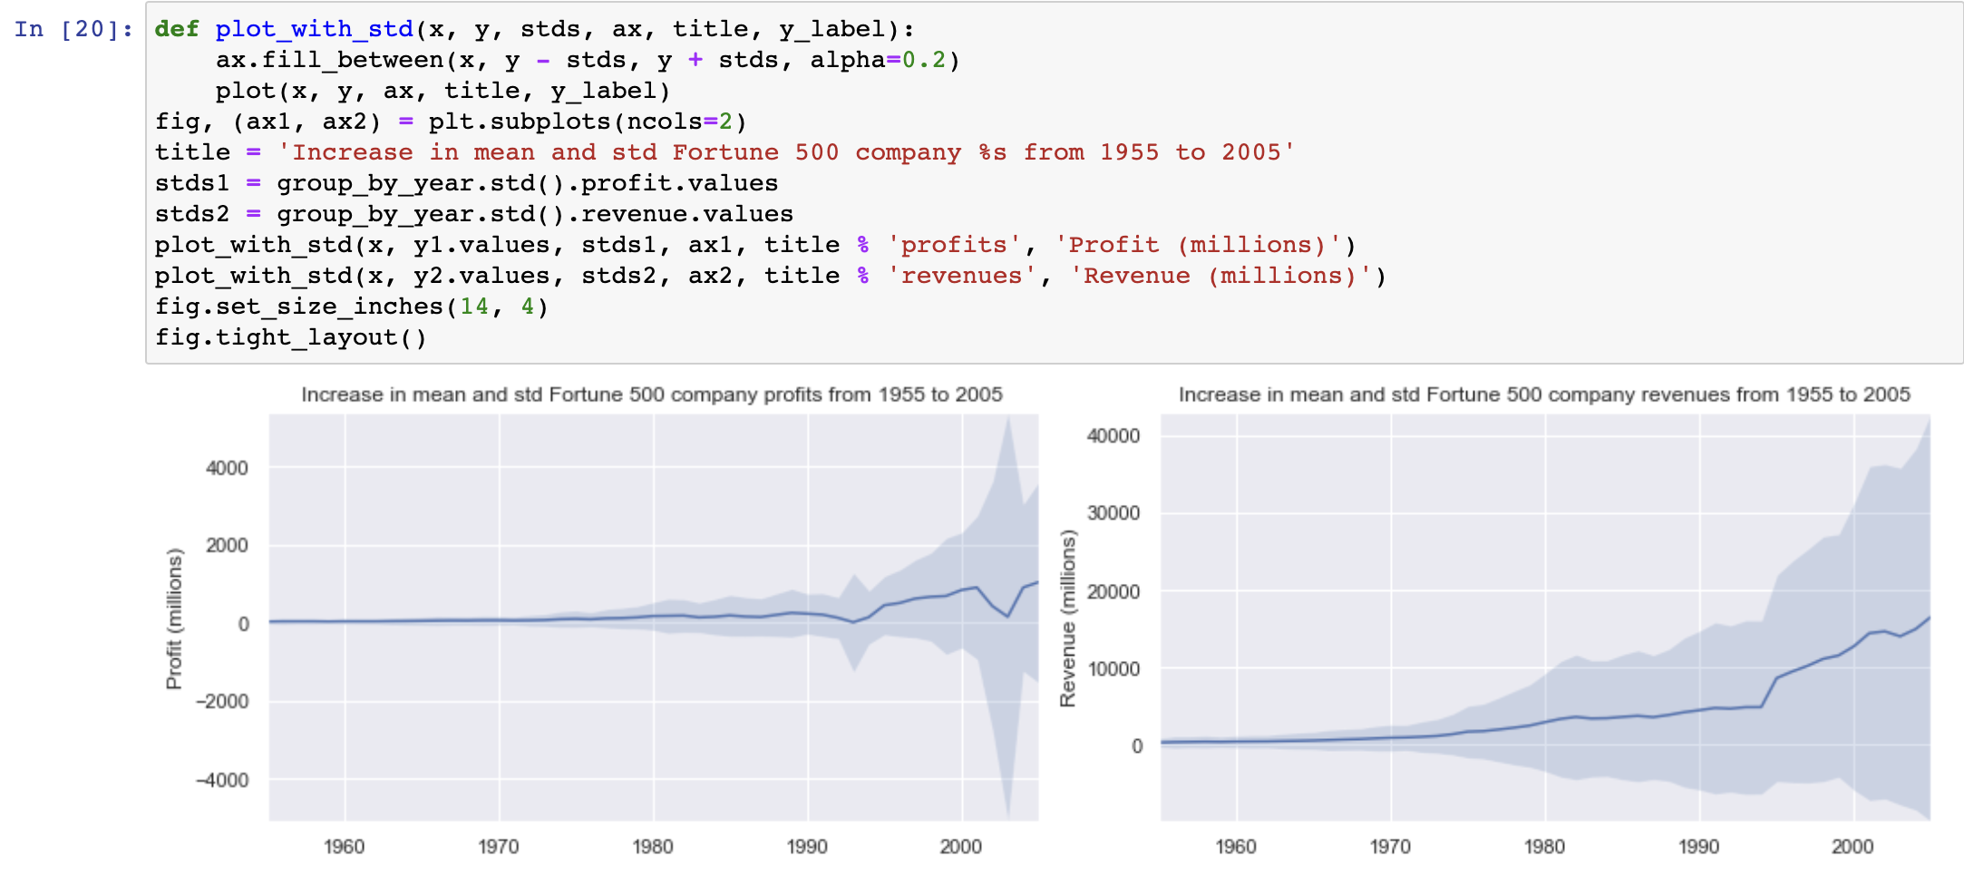
FURTHER ANALYSIS (cont.)
Let’s superimpose these plots with +/- their standard deviations...

Slide 33
CONCLUSIONS
The standard deviations are huge! Some Fortune 500 companies make billions while others lose billions, and the risk has increased along with rising profits over the years.
Perhaps some companies perform better than others; are the profits of the top 10% more or less volatile than the bottom 10%?
There are plenty of questions that we could look into next, and it’s easy to see how the flow of working in a notebook can match one’s own thought process.

Slide 34
3.
EXPLORATORY DATA ANALYSIS

Slide 35
ONE MORE EXAMPLE … THE DATASET USED FOR THIS MODEL IS STRAIGHTFORWARD. WE ARE TRYING TO PREDICT THE WEIGHT OF THE INDIVIDUAL BASED ON THEIR HEIGHT. SO LET US FIRST SEE IF THERE IS ANY CORRELATION BETWEEN HEIGHT AND WEIGHT OF THE INDIVIDUAL....
BEFORE BUILDING ANY MODEL, IT IS ESSENTIAL TO UNDERSTAND THE DATA SET. EDA (EXPLORATORY DATA ANALYSIS) IS A CRUCIAL STEP IN BUILDING ANY SUCCESSFUL MODEL.

Slide 36
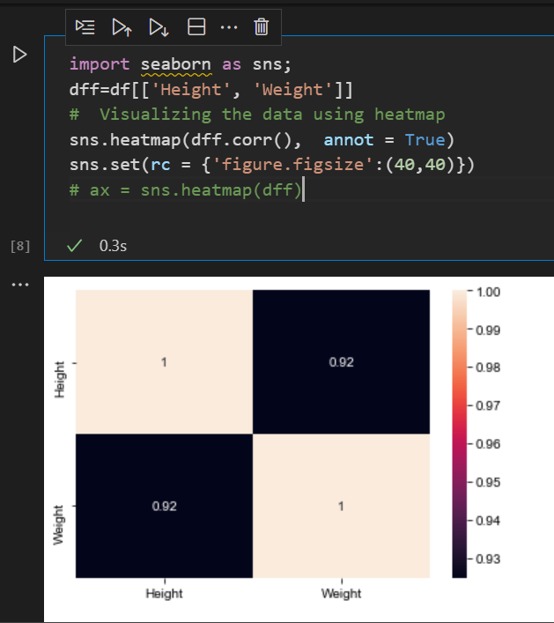
DESCRIPTIVE STATISTICS
Run heatmap plot to check for correlation between dependent and independent variables.
Heatmap is a two-dimensional visual representation of the variables. It is considered one of the best visual graphical representations when you want to show complex data. It is comprised of square boxes, and the x-axis and y-axis represent the variables.
Dependent variable: Weight
Independent variable: Height
Regarding correlation:
Values closer to 1 show a high correlation, and values closer to 0 show the lowest correlation.
A positive correlation value shows that the variables are positively correlated. For example, taller individuals usually weigh more.
A negative correlation value shows that the variables are negatively correlated.

Slide 37
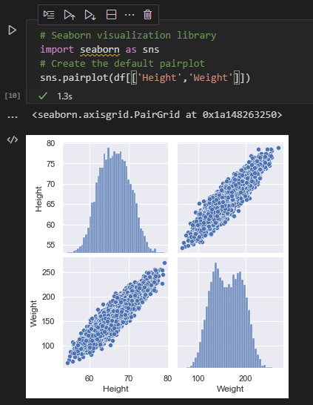
DESCRIPTIVE STATISTICS (cont.)
Plot a pair plot to visually represent the positive/negative correlation between the variables.
Based on the pair plot, the Height is positively correlated to Weight of the individual.
Now, let's build a model that will predict the individual's weight based on height....

Slide 38
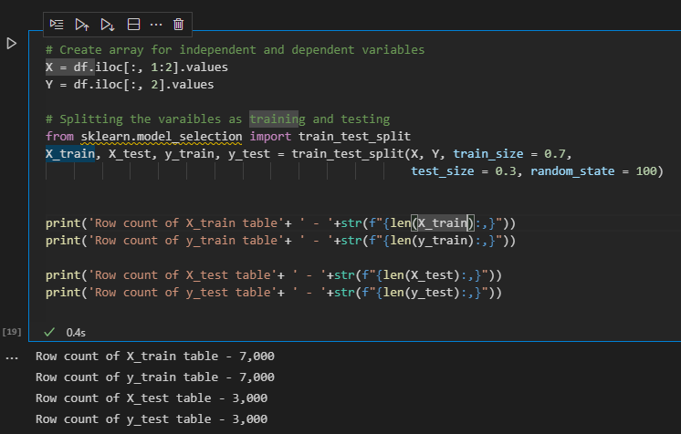
CREATE, TRAIN AND TEST DATASET
We are first splitting the dataset into train and test data sets. We then build the model based on the train data set and test it on the test dataset...

Slide 39
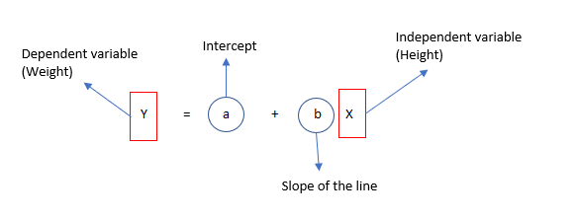
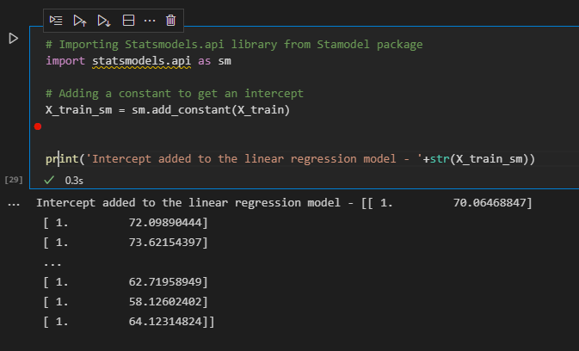
BUILD A LINEAR REGRESION MODEL
We are ready to build a simple linear regression model.
We will be using existing python packages to build the model.
Sklearn
Statsmodel
The equation for simple linear regression:
The Statsmodel library that we will be using for building the linear regression model will fit a line for our dataset. Let's input the intercept value using the Statsmodel library.

Slide 40
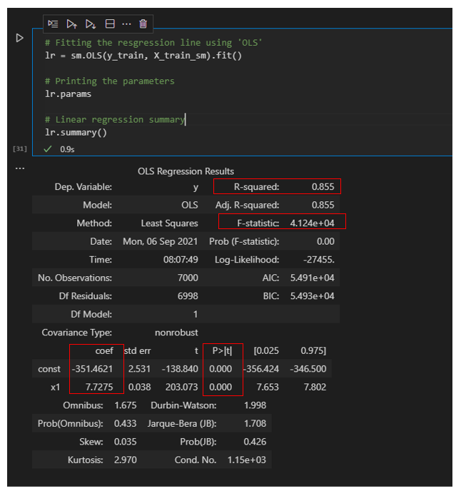
FIT THE REGRESION LINE
R-squared value is 0.855. This shows that 85.5% of the variance in the weight can be explained by height.
F statistic is pretty low, which shows that the model fit is statistically significant.
The coefficient for height is 7.7 and P-value is close to 0. This shows that the coefficient is statistically significant.
Based on the summary, we can now derive the linear regression equation using intercept and slope.
Weight = -351.4621 + 7.7275 * height

Slide 41
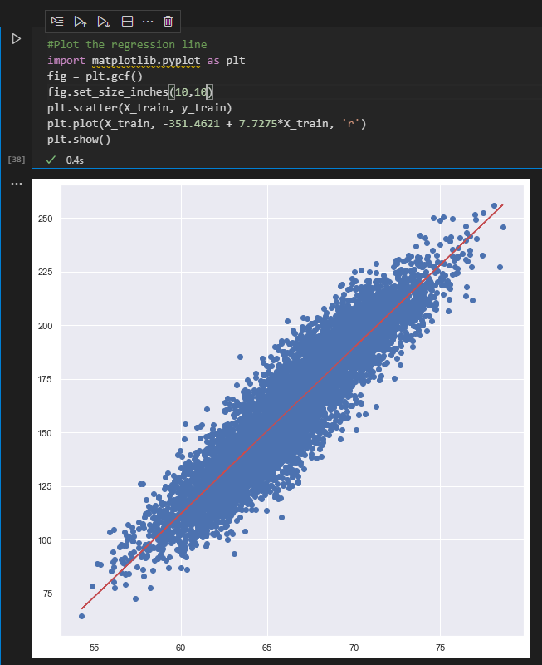
PLOTING
Plot the regression line using the equation:

Slide 42
DATA VISUALIZATION
AND
PREPARATION
This presentation is supported by the project "Education 4.0: Living Labs for the Students of the Future (LLSF)", Contract #2021-1-RO01-KA220-HED-000032176, Erasmus+ KA220-HED

Slide 43

BIO
Bogdan-Costel MOCANU is an Assistant Professor and postdoctoral researcher at the Faculty of Automatic Control and Computers, Department of Computer and Information Technology of UNSTPB. He earned his Ph.D. in 2019 and continuously demonstrated remarkable growth and improvement in his expertise and contributions in multiple areas of research that includes: Peer-to-Peer systems, Distributed systems, Cloud computing, Big Data, Real-time scheduling, and Data security.
BOGDAN MOCANU

Slide 44
WE USE BIG DATA VISUALIZATION TO SEE WHAT OTHERS CAND’T SEE

Slide 45
1.
UNDESTRANDING BIG DATA

Slide 46
328,770 PB
of data are processed each day
Notes:
The amount of data processed every day is staggering. According to the latest estimates, 328.77 million terabytes of data are created each day. That's equivalent to 120 zettabytes per year, or enough data to fill 120 trillion DVDs.
This data comes from a variety of sources, including:
Social media: Users generate billions of pieces of content on social media platforms like Facebook, Twitter, and Instagram every day.
Video streaming: People watch billions of hours of video on streaming services like Netflix, YouTube, and Hulu every day.
Online shopping: Consumers purchase billions of dollars worth of goods and services online every day.
The Internet of Things (IoT): Billions of IoT devices, such as smart thermostats, security cameras, and wearable devices, are generating data all the time.

Slide 47
4.95 PB
6.3 M.
149,531
4,000,000
Traffic produced by end users
Posts shared on Facebook
141,6 M.
Google searches
Video hours viewed
Hundreds of M.
Emails sent
Texts messages sent
Notes:
As of September 2023, there are approximately 4.95 billion internet users around the world. If we assume that each user produces an average of 1 megabyte of traffic per minute then the total traffic produced by end users in 1 minute would be approximately 4.95 petabytes

Slide 48
Big Data global market size forecast 2030
https://www.verifiedmarketresearch.com/product/global-big-data-market-size-and-forecast/
Notes:
The global big data market size is estimated to be USD 307.52 billion in 2023. This is expected to grow during the forecast period of 2023-2030, reaching USD 745.15 billion by 2030.
The growth of the big data market is attributed to the increasing adoption of big data technologies by enterprises to improve their operational efficiency and decision-making. Big data technologies are being used in a wide range of industries, including, healthcare, retail, manufacturing, and others.
Some of the key factors driving the growth of the big data market include:
Increasing volume, velocity, and variety of data
Growing demand for big data analytics to extract insights from data
Rising adoption of cloud-based big data solutions
Government initiatives to promote the adoption of big data technologies

Slide 49
MAJOR BENEFITS OF BIG DATA
Answer more questions, more completely (powerful big data business intelligence platform)
Notes:
Big data is a collection of large and complex datasets that are difficult to process using traditional data processing methods. Big data can come from a variety of sources, such as social media, financial transactions, and sensor data.
Answer more questions more completely: Big data can help businesses to answer a wider range of questions more completely. For example, a retailer might use big data to analyze customer purchase history and identify trends. This information can then be used to develop more targeted marketing campaigns.

Slide 50
MAJOR BENEFITS OF BIG DATA
Answer more questions, more completely (powerful big data business intelligence platform)
Improve operational efficiency
Notes:
Improve operational efficiency: Big data can help businesses to improve their operational efficiency. For example, a manufacturing company might use big data to identify areas where production processes can be streamlined. This can lead to reduced costs and increased productivity.

Slide 51
MAJOR BENEFITS OF BIG DATA
Answer more questions, more completely (powerful big data business intelligence platform)
Improve operational efficiency
Make better decisions
Notes:
Make better decisions: Big data can help businesses to make better decisions. For example, a bank might use big data to assess the risk of lending money to a particular customer. This can help the bank to reduce its risk of losses.

Slide 52
MAJOR BENEFITS OF BIG DATA
Answer more questions, more completely (powerful big data business intelligence platform)
Make better decisions
Empower a new generation of employees (data scientists, data-ops, data architects)
Faster and better decision making
Notes:
lNew emploees:
data scientists (develop, test and deploy new models),
data ops (handle the infrastructure and configs)
Data architects (THE MATRIX Architect – hande model, data pipelines arhitectures)

Slide 53
MAJOR BENEFITS OF BIG DATA
Answer more questions, more completely (powerful big data business intelligence platform)
Faster and better decision making
Become confident in your accurate data (solving the problem of inaccurate, incomplete view of the data)
Empower a new generation of employees (data scientists, data-ops, data architects)
Develop new products and services
Notes:
Develop new products and services: Big data can help businesses to develop new products and services. For example, a technology company might use big data to identify new features that would be popular with its users. This can help the company to stay ahead of the competition.

Slide 54
2. DATA VISUALIZATION
Notes:
Data visualization is the graphical representation of data. It is used to communicate complex information in a clear and concise way. Data visualization can help to identify trends, patterns, and relationships in data that would be difficult to see using traditional data analysis methods.

Slide 55
The art of turning raw numerical data into a visual representation, that lets people understand its significance

Slide 56
The art of turning raw numerical data into a visual representation, that lets people understand its significance
The amount of data in the world is too much for humans to analyze without special instruments

Slide 57
The art of turning raw numerical data into a visual representation, that lets people understand its significance
The amount of data in the world is too much for humans to analyze without special instruments
Allows instant scanning of massive datasets and deriving patterns

Slide 58
The art of turning raw numerical data into a visual representation, that lets people understand its significance
The amount of data in the world is too much for humans to analyze without special instruments
Allows instant scanning of massive datasets and deriving patterns
Patterns are used to derive insights and then use them for better decision making

Slide 59
DATA VISUALIZATION – MAIN BENEFITS
Simplifies the complex quantitative information
Notes:
Improved understanding of data: Data visualization can help people to better understand data by presenting it in a visual format. Visuals can be more engaging and easier to remember than text or numbers.

Slide 60
DATA VISUALIZATION – MAIN BENEFITS
Simplifies the complex quantitative information
More efficient communication
Notes:
More effective communication: Data visualization can help to communicate complex information in a clear and concise way. This can be useful for communicating information to a variety of audiences, including both technical and non-technical audiences.

Slide 61
DATA VISUALIZATION – MAIN BENEFITS
Simplifies the complex quantitative information
More efficient communication
Identifies the areas for improvement
Notes:
Identification of trends and patterns: Data visualization can help to identify trends and patterns in data that would be difficult to see using traditional data analysis methods. For example, a line chart might show a trend of increasing sales over time.

Slide 62
DATA VISUALIZATION – MAIN BENEFITS
Simplifies the complex quantitative information
More efficient communication
Identifies the areas for improvement
Improved decision-making
Notes:
Improved decision-making: Data visualization can help people to make better decisions by providing them with a clear and concise understanding of the data. For example, a bar chart might show that one product is selling better than another. This information can be used to make decisions about which products to stock and promote.

Slide 63
DATA VISUALIZATION – MAIN BENEFITS
Simplifies the complex quantitative information
More efficient coomunication
Identifies the areas for improvement
Improved decision-making
Identifies new or hidden patterns
Notes:
Identification of trends and patterns: Data visualization can help to identify trends and patterns in data that would be difficult to see using traditional data analysis methods. For example, a line chart might show a trend of increasing sales over time.

Slide 64
3.
CHARACTERISTICS OF DATA VISUALIZATION

Slide 65
CLARITY – dataset is complete and relevant. This enables the data scientist to use the new patterns yielded from the data
Notes:
There are a number of characteristics of good data visualization, including:
Clarity: The visualization should be easy to understand, even for people with no prior knowledge of the data.

Slide 66
CLARITY – dataset is complete and relevant. This enables the data scientist to use the new patterns yielded from the data
ACURRACY – ensure using appropriate graphical representations to convey the right message
Notes:
Accuracy: The visualization should accurately represent the data.

Slide 67
CLARITY – dataset is complete and relevant. This enables the data scientist to use the new patterns yielded from the data
ACURRACY – ensure using appropriate graphical representations to convey the right message
EFFICIENCY – efficient visualization technique that highlights all the data points
Notes:
Efficiency: The visualization should be visually appealing and engaging.
some tips for creating effective data visualizations
Choose the right visualization type for the data you are trying to communicate.
Use clear and concise labels and titles.
Use color and other visual elements sparingly and effectively.
Avoid cluttering the visualization with too much information.
Test the visualization with your target audience to make sure it is understood.

Slide 68
4.
DATA VISUALIZATION FUNDAMENTAL TYPES AND CHARTS

Slide 69
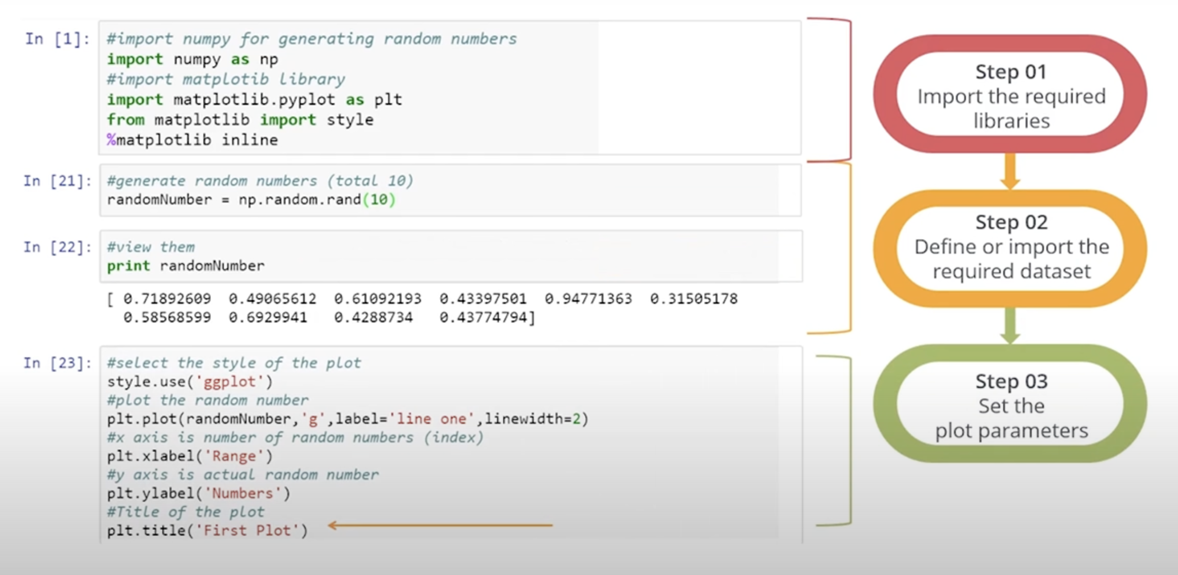
BASIC PLOT

Slide 70
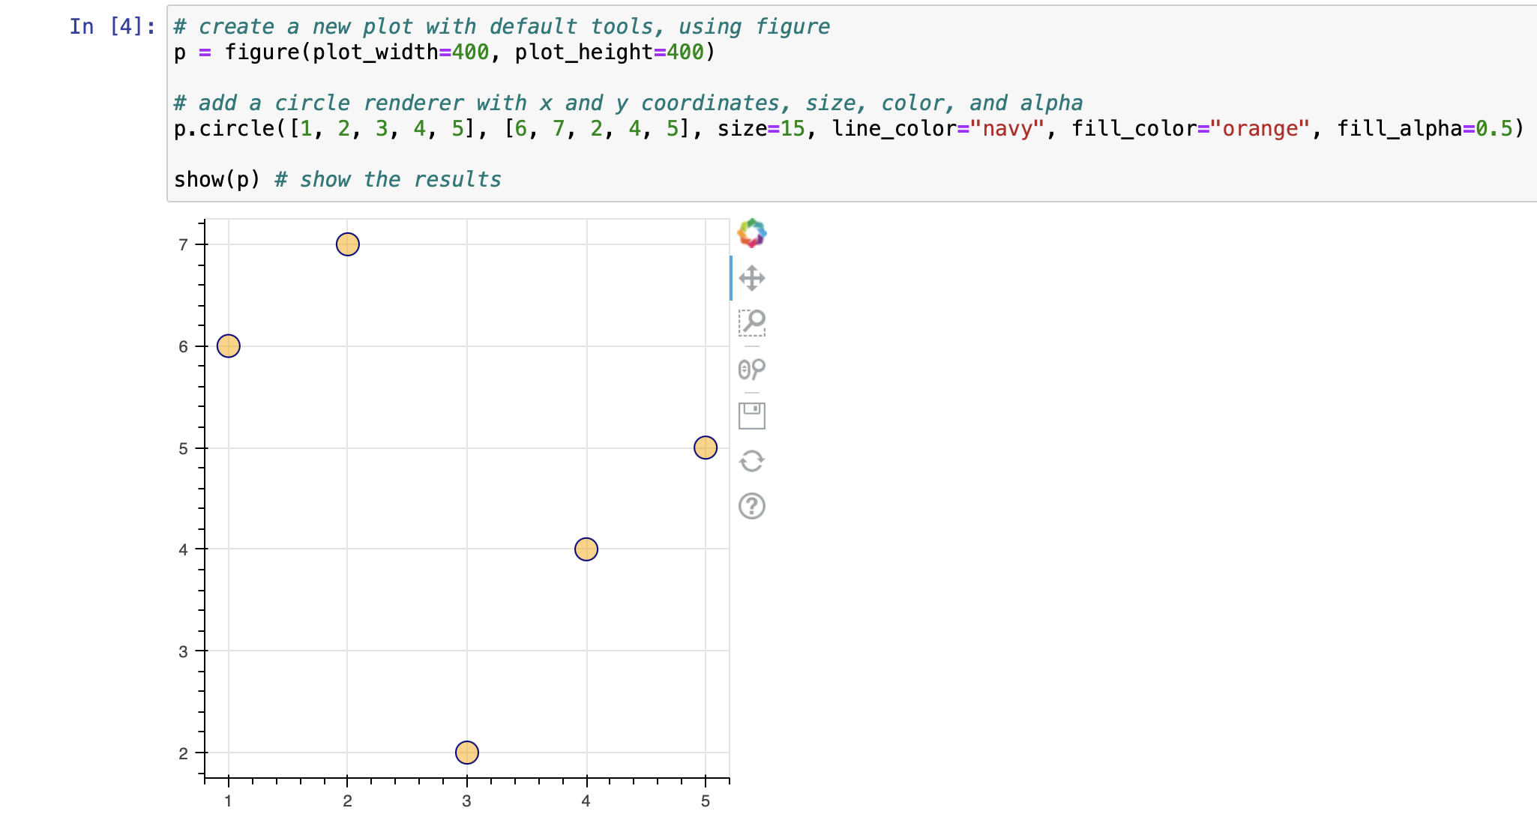
SCATER PLOT
uses dots to represent values for two different numeric variables
Scatter plots’ - to observe and show relationships between two numeric variables
Identification of correlational relationships are common with scatter plots

Slide 71
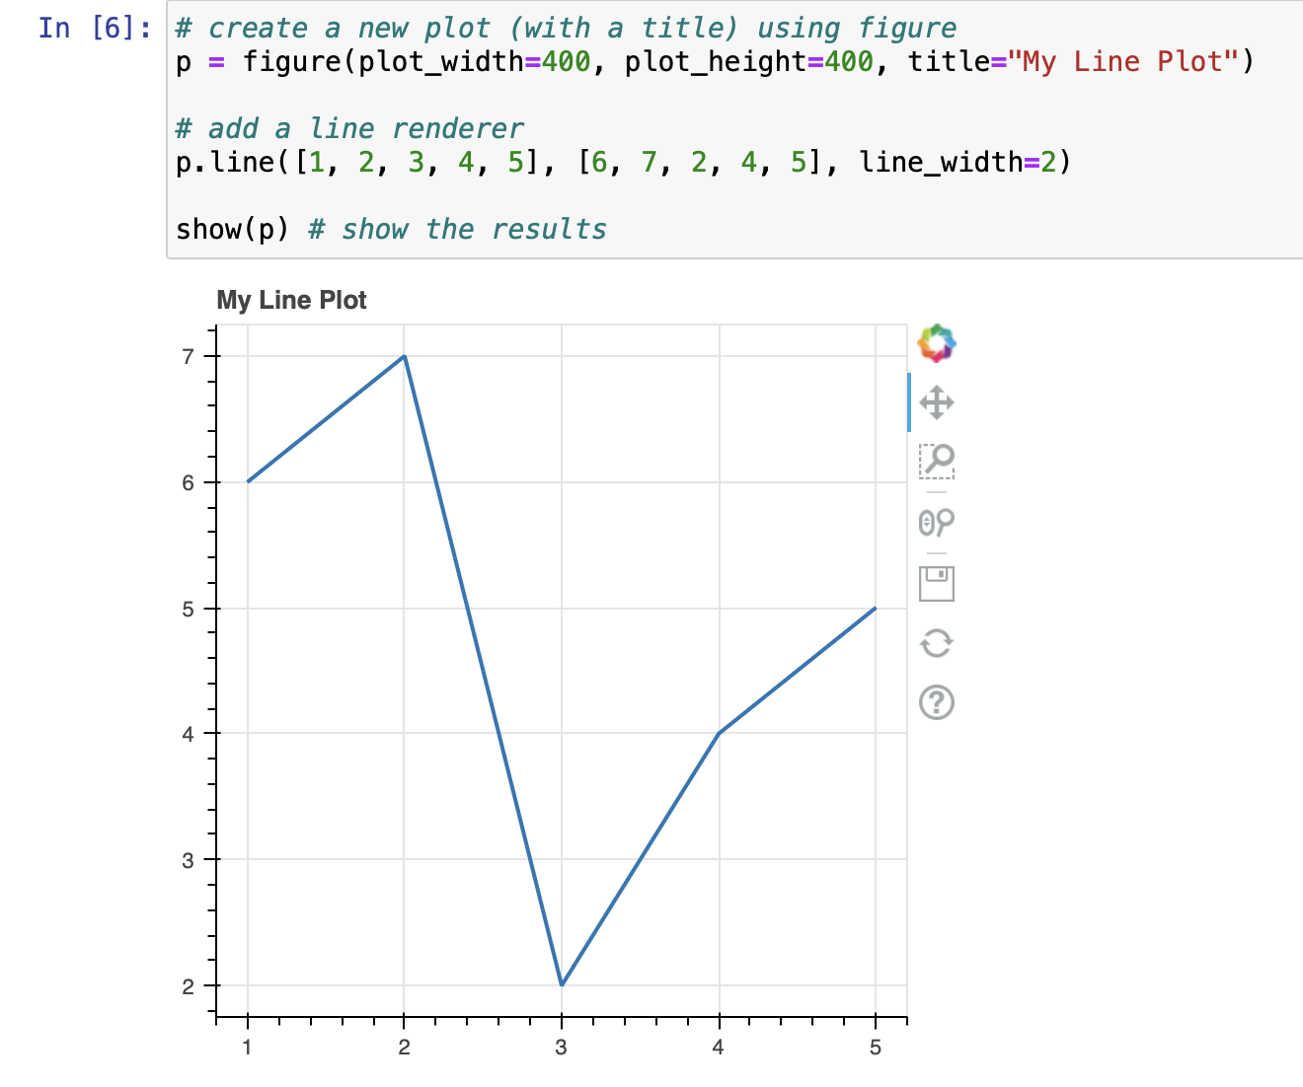
LINE PLOT
displays information as a series of data points called 'markers' connected by straight line segments
It is best to use a line plot when comparing fewer than 25 numbers.
It is a quick, simple way to organize data.

Slide 72
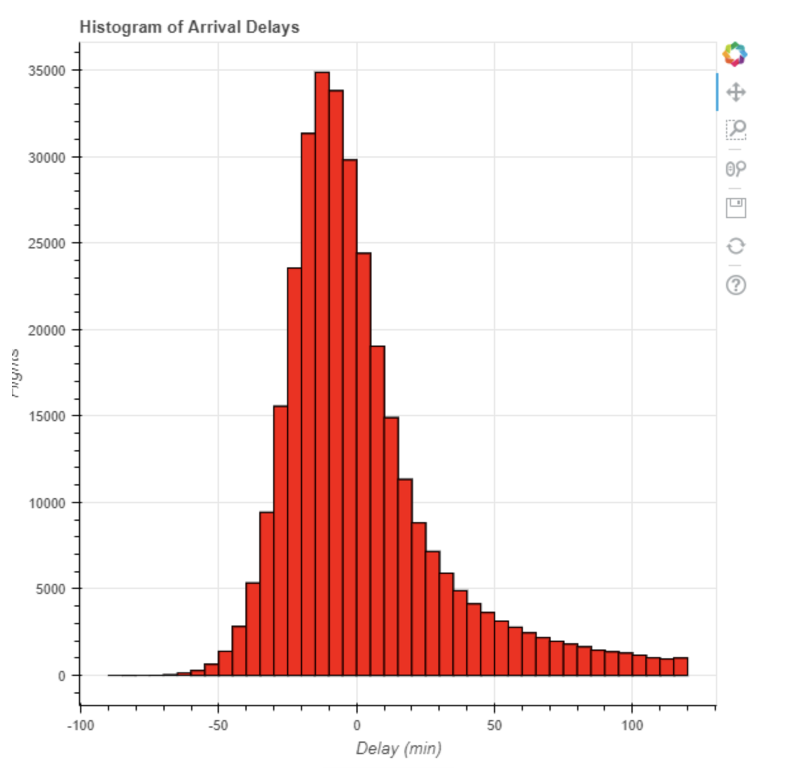
HISTOGRAM
common choice for an initial visualization of a single variable because it shows the distribution of the data
x-position is the value of the variable grouped into intervals called bins
the height of each bar represents the count (number) of data points in each interval

Slide 73
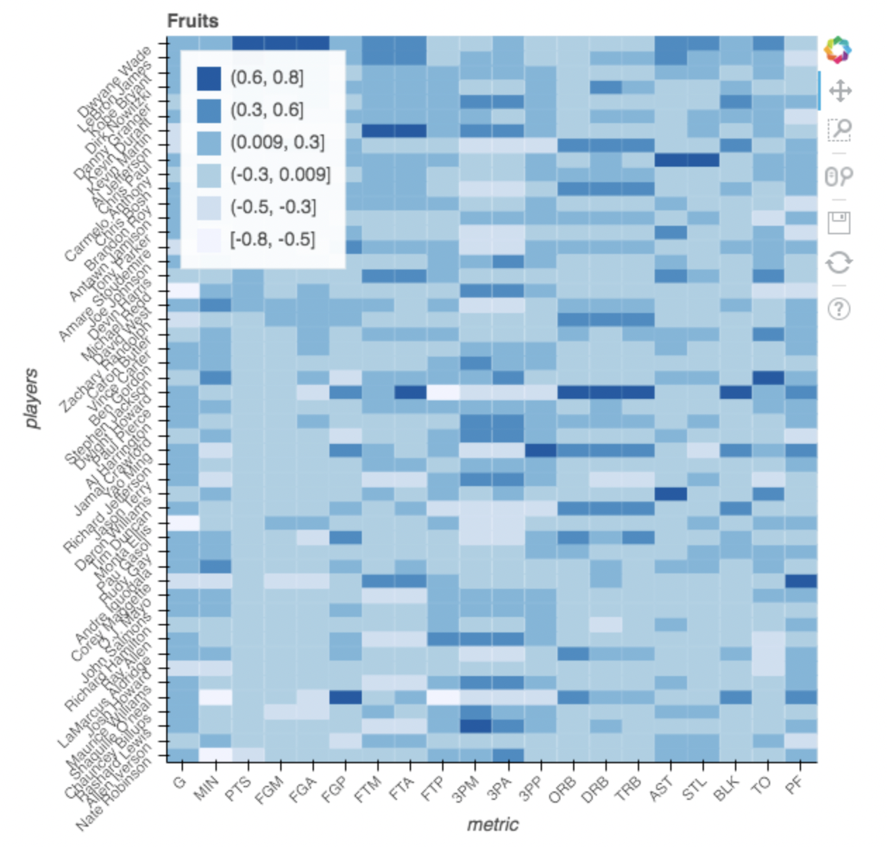
HEAT MAP
shows magnitude of a phenomenon as color in two dimensions
The variation in color may be by hue or intensity, giving obvious visual cues to the reader about how the phenomenon is clustered or varies over space
two fundamentally different categories of heat maps:
the cluster heat map
the spatial heat map

Slide 74
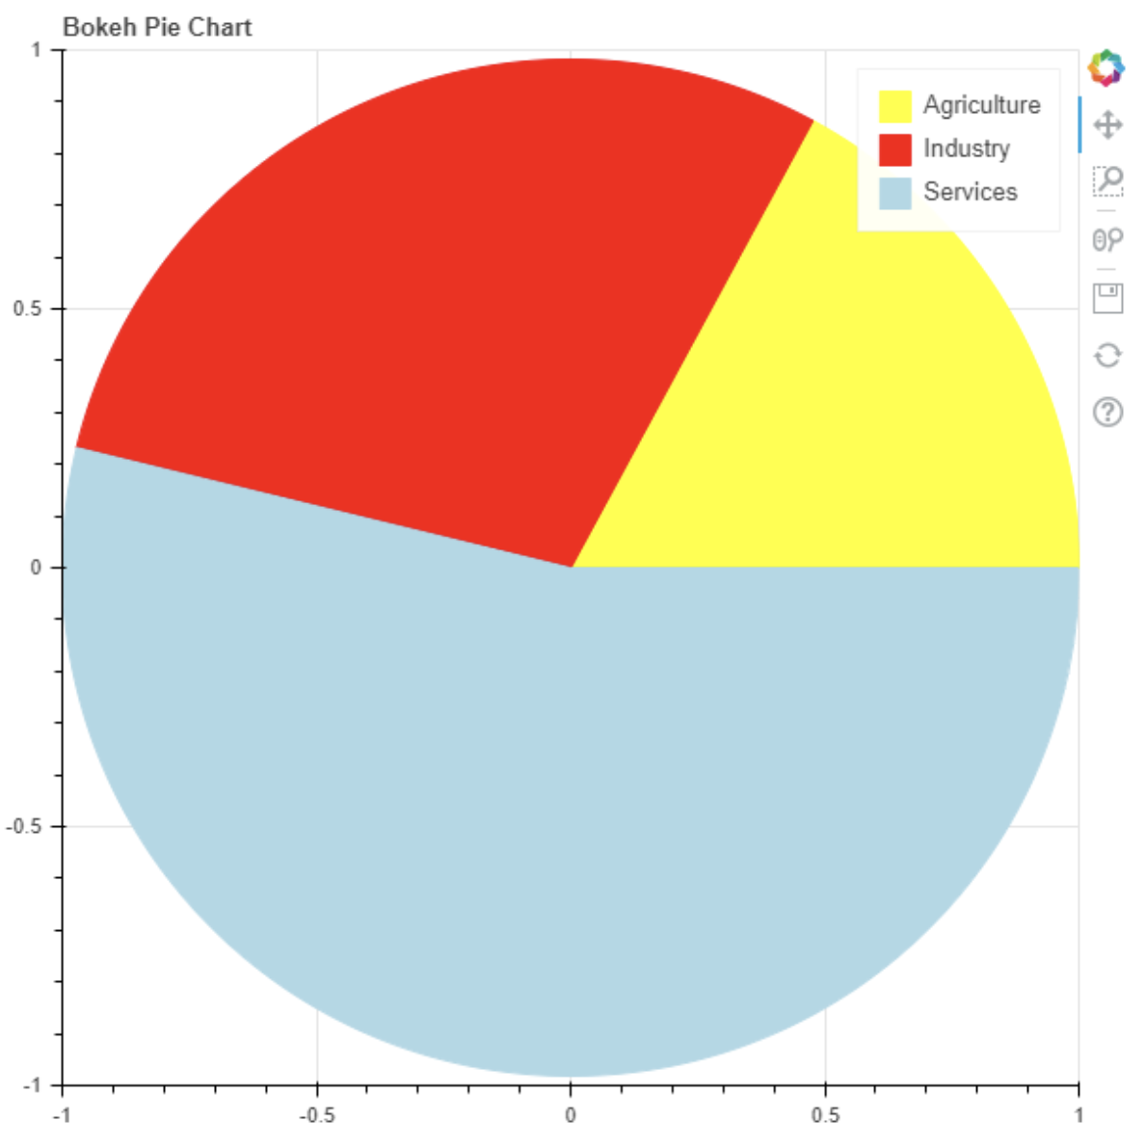
PIE CHART
trying to work out the composition of something
to compare areas of growth within a business such as turnover, profit and exposure
It is best practice to never have any more than 7 categories as it becomes harder for the eye to distinguish relativity of size between each section

Slide 75
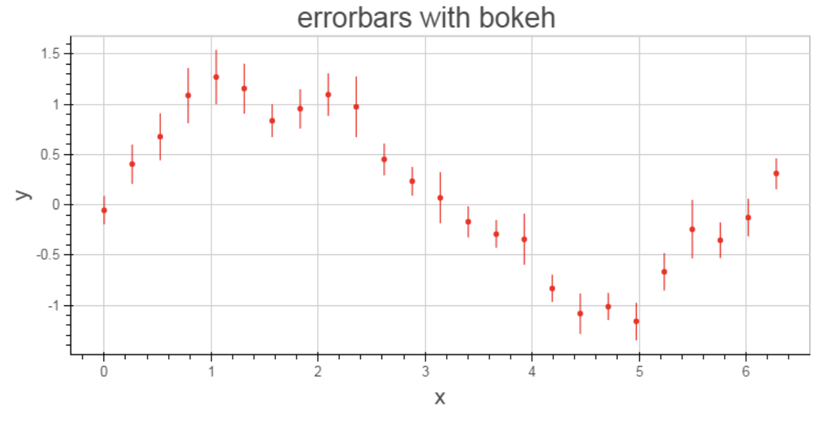
ERROR BAR
compare visually two quantities if various other conditions hold
can also suggest goodness of fit of a given function, i.e., how well the function describes the data
used as a direct manipulation interface for controlling probabilistic algorithms for approximate computation

Slide 76
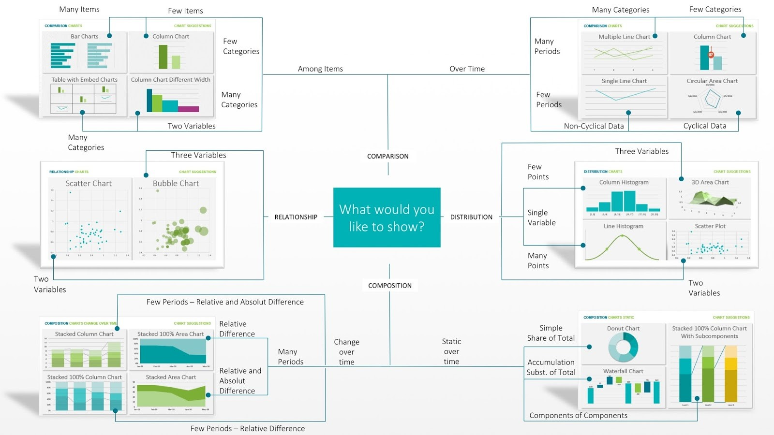
https://www.guidetoinsights.com/blog/All%20Articles/create_beautiful_data_visuals.html

Slide 77
4.
DATA PREPARATION
Notes:
Data preparation is the process of cleaning, organizing, and transforming data into a format that can be easily analyzed and used. It is an essential step in any data science project, as it ensures that the data is high-quality and reliable.

Slide 78
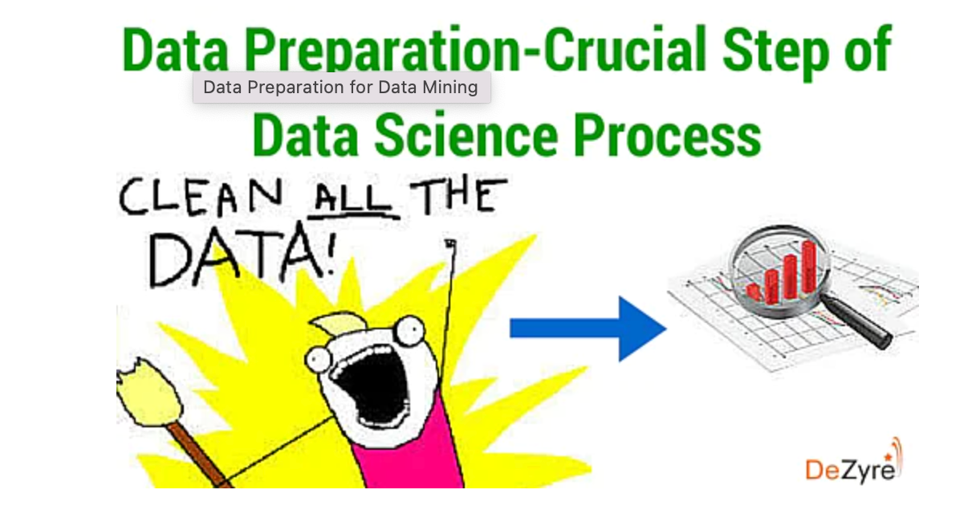
DATA SCIENTISTS SPEND ABOUT 50-80% OF THEIR TIME ON DATA PREPARATION TASKS, INCLUDING LOADING AND CLEANING DATA

Slide 79
WHY WE NEED DATA PREPARATION ?
To filter unstructured, inconsistent, and disordered data
Notes:
To filter unstructured, inconsistent, and disordered data on data preparation, you can use a variety of techniques, including:
Regular expressions: Regular expressions are a powerful tool for pattern matching and text extraction. They can be used to filter unstructured data by finding and removing specific patterns or sequences of characters. For example, you could use a regular expression to remove all email addresses from a piece of text.
Natural language processing (NLP): NLP is a field of computer science that deals with the interaction between computers and human (natural) languages. NLP techniques can be used to extract meaning from unstructured text data and to identify relationships between different entities. This information can then be used to filter the data in a variety of ways. For example, you could use NLP to filter a list of customer reviews by identifying the most common complaints.
Machine learning: Machine learning algorithms can be trained to learn the patterns and relationships in data. This information can then be used to filter the data in a variety of ways. For example, you could train a machine learning algorithm to identify spam emails.

Slide 80
WHY WE NEED DATA PREPARATION ?
To filter unstructured, inconsistent, and disordered data
Connecting data from real-time multiple data sources
Notes:
Data fusion
Connecting data from real-time multiple data sources is a challenging but important task for many organizations. It can be difficult to integrate data from different sources in a timely and efficient manner, and to ensure that the data is consistent and accurate.
Once the data from different sources has been integrated, it can be used for a variety of purposes, such as:
Real-time analytics: Data from real-time multiple data sources can be used to perform real-time analytics to identify trends, patterns, and anomalies. For example, a company could use real-time analytics to track social media sentiment analysis
Machine learning: Data from real-time multiple data sources can be used to train and deploy machine learning models. For example, a company could use a machine learning model to predict customer churn or to recommend products to customers.
Business intelligence: Data from real-time multiple data sources can be used to generate business intelligence reports and dashboards. This information can be used to make better business decisions.
Here are some examples of how organizations are using real-time data from multiple sources:
Twitter: Twitter can be used to track social media sentiment towards a brand or to identify customer service issues.
Netflix: Netflix can be used to track customer viewing habits and to recommend new content to customers.
Financial institutions: Financial institutions can use real-time data from multiple sources to identify fraudulent transactions and to manage risk.
Retailers: Retailers can use real-time data from multiple sources to track inventory levels, to optimize supply chains, and to target customers with personalized marketing campaigns.

Slide 81
WHY WE NEED DATA PREPARATION ?
To filter unstructured, inconsistent, and disordered data.
Connecting data from real-time multiple data sources
To reduce the risk of errors
Notes:
Poor data quality can lead to errors in big data analysis and machine learning models. Data preparation helps to reduce the risk of errors by ensuring that the data is high-quality and reliable.

Slide 82
WHY WE NEED DATA PREPARATION ?
To filter unstructured, inconsistent, and disordered data
Connecting data from real-time multiple data sources
To reduce the risk of errors
To improve the efficiency of big data projects
Notes:
Data preparation can help to improve the efficiency of big data projects by making it easier to analyze and use data. This can free up data scientists to focus on more complex tasks, such as building and training machine learning models.

Slide 83
DATA PREPARATION PROCESS
DATA COLLECTION
EXPLORATORY DATA ANALYSIS
DEPLOYMENT
1
3
5
2
4
DATA CLEANING
MODELING

Slide 84
DEMO

Slide 85

THANKS!
Any questions?
Find us here
@ciprian.dobre
ciprian.dobre@upb.ro
@bogdan_costel.mocanu
bogdan_costel.mocanu@upb.ro

